Slide 1

Food Desert Impact on Health
Sundari Arunarasu + Paulina Grzybowicz

Slide 2
Objectives
Sundari:
Explore the relationship between access to grocery stores and food services on diabetes, as well as healthcare providers
Attempt to identify differences between urban and rural counties in Oregon that influence health outcomes (diabetes prevalence)
Paulina:
Showcase the relationship between food deserts and health outcomes in Chicago
Explore the specific variables that dictate food deserts (grocery stores, income, food stamps, etc) and their impact on health outcomes
Understand significance of these variables + use them to evaluate potential solutions

Slide 3

Food Deserts
“Food desert, an impoverished area where residents lack access to healthy foods. Food deserts may exist in rural or urban areas and are associated with complex geographic and socioeconomic factors, as well as with poor diet and health disorders such as obesity.”
No standard definition
Grocery store prevalence isn’t the only variable
Public transport
Income
Culture
Notes:
What people eat is severely limited by options available to them and what theycan afford.
Limitations
Possible to overlook food deserts when looking at US government data
NAICS is standard for federal statistical agencies in classifying business establishments nd it categorizes retail outlets that sell foood
Small corner grocery stores are statistically lumped with supermarkets
Corner stores have primarily junk food, limied food
At mercy of the person behind the counter

Slide 4
Diet’s Impact on Health
Food balance is significant contributor to increased rates of obesity
Diet-related health outcomes:
Heart disease
Diabetes
High blood pressure
Higher-calorie, energy- dense foods are cheaper than low-energy, nutritious foods
Lower access to healthy food → increased premature death, chronic health conditions, etc

Slide 5
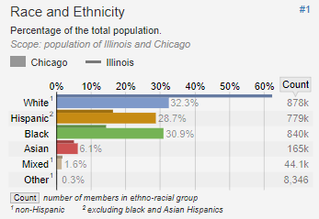
Chicago Food Deserts
Chicago demographics
Split 30/30/30
De facto segregation
Housing policy in 1930s/40s
Communities of color impacted most by food deserts
Lower SES
More corner stores, less supermarkets
Higher rates of obesity + diabetes in southern/western neighborhoods

Slide 6
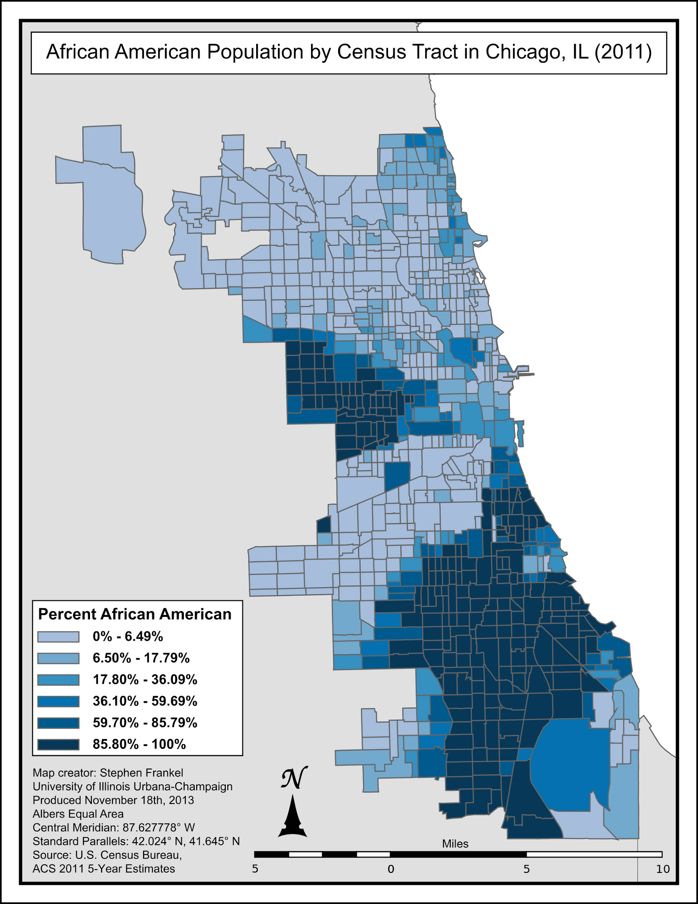
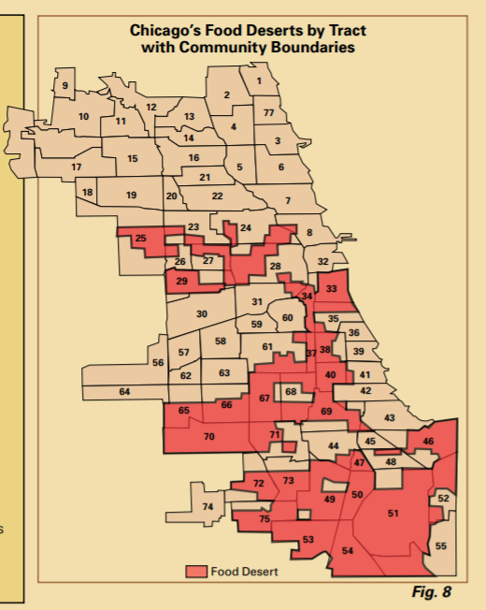

Slide 7
Chicago: Data Collection
Data by Chicago Neighborhood
U.S Census
Population
Racial Distribution
City of Chicago Data
Median Income
Unemployment Rate
Number of Grocery Stores
Urban Farms
Food Carts
Chicago Health Atlas
Food Stamps
Limited Food Access
Food Insecurity
Household Emergency Food Use
Diabetes Rate
Diabetes Related Deaths
Obesity Rate
Diet-Related Deaths
General Socioeconomic Status Food Health

Slide 8
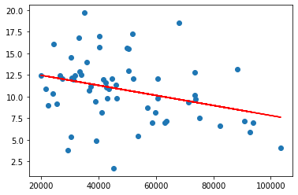
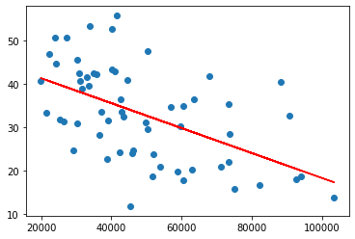
Chicago: Visualizations and Trends
Diabetes Rate
Obesity Rate
Median Income
Median Income
R² = 0.09948359220222736 R² = 0.285551651010049

Slide 9
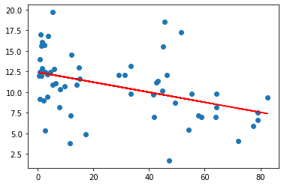
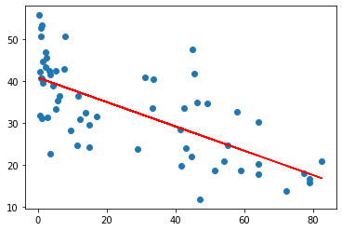
Chicago: Visualizations and Trends
Diabetes Rate
Obesity Rate
Percentage Non-Hispanic White
Percentage Non-Hispanic White
R² = 0.05152733436080459 R² = 0.4786339243941223

Slide 10
Chicago: Findings
Relationship to Diabetes Rates
SES Indicators
Poverty Rate, Unemployment Rate, Education Level
Median Income
Food Related
Food Stamps
Easy Access To Food, Grocery Store #
Clear Racial Patterns
Higher White Populations, Lower Rates
Higher Black/Hispanic Populations, Higher Rates
In general, all relationships to Obesity Rate stronger

Slide 11
Chicago: Findings
Relationship to Diabetes Rates
SES Indicators
Poverty Rate, Unemployment Rate, Education Level
Median Income
Food Related
Food Stamps
Easy Access To Food, Grocery Store #
Clear Racial Patterns
Higher White Populations, Lower Rates
Higher Black/Hispanic Populations, Higher Rates
In general, all relationships to Obesity Rate stronger

Slide 12
Chicago: Mediation Analysis
Idea: Food Access (and other Food-Desert Variables) act as a mediator between SES and Diabetes Rate
Process:
Baron + Kenny’s steps
3 sets of regressions
Results:
Process:
2. Sobel Test or Bootstrapping
Test Significance
X: Median Income | Y: Diabetes Rate | P = 0.0141
X: Median Income | M: Easy Access to Food | P = 5.289e-10
X+M: Median Income + % Easy Access to Food | Y: Diabetes Rate | X → Y p = 0.299 M → Y p = 0.299
Significance Test |  | Weakens X → Y

Slide 13
Chicago: Mediation Analysis
X: Median Income | Y: Obesity Rate | p = 1.03e-06
X: Median Income | M: Easy Access to Food | P = 4.57e-09
X+M: Median Income + % Easy Access to Food | Y: Obesity Rate | X → Y p = 0.114 M → Y p = 5.41e-0.5
Significance Test |  | Significant
X: Poverty Rate | Y: Diabetes Rate | P = 0.0322
X: Poverty Rate | M: Easy Access to Food | P = 2.39e-09
X+M: Poverty + % Easy Access to Food | Y: Diabetes Rate | X → Y p = 0.822 M → Y p = .0516
Significance Test |  | Significant

Slide 14
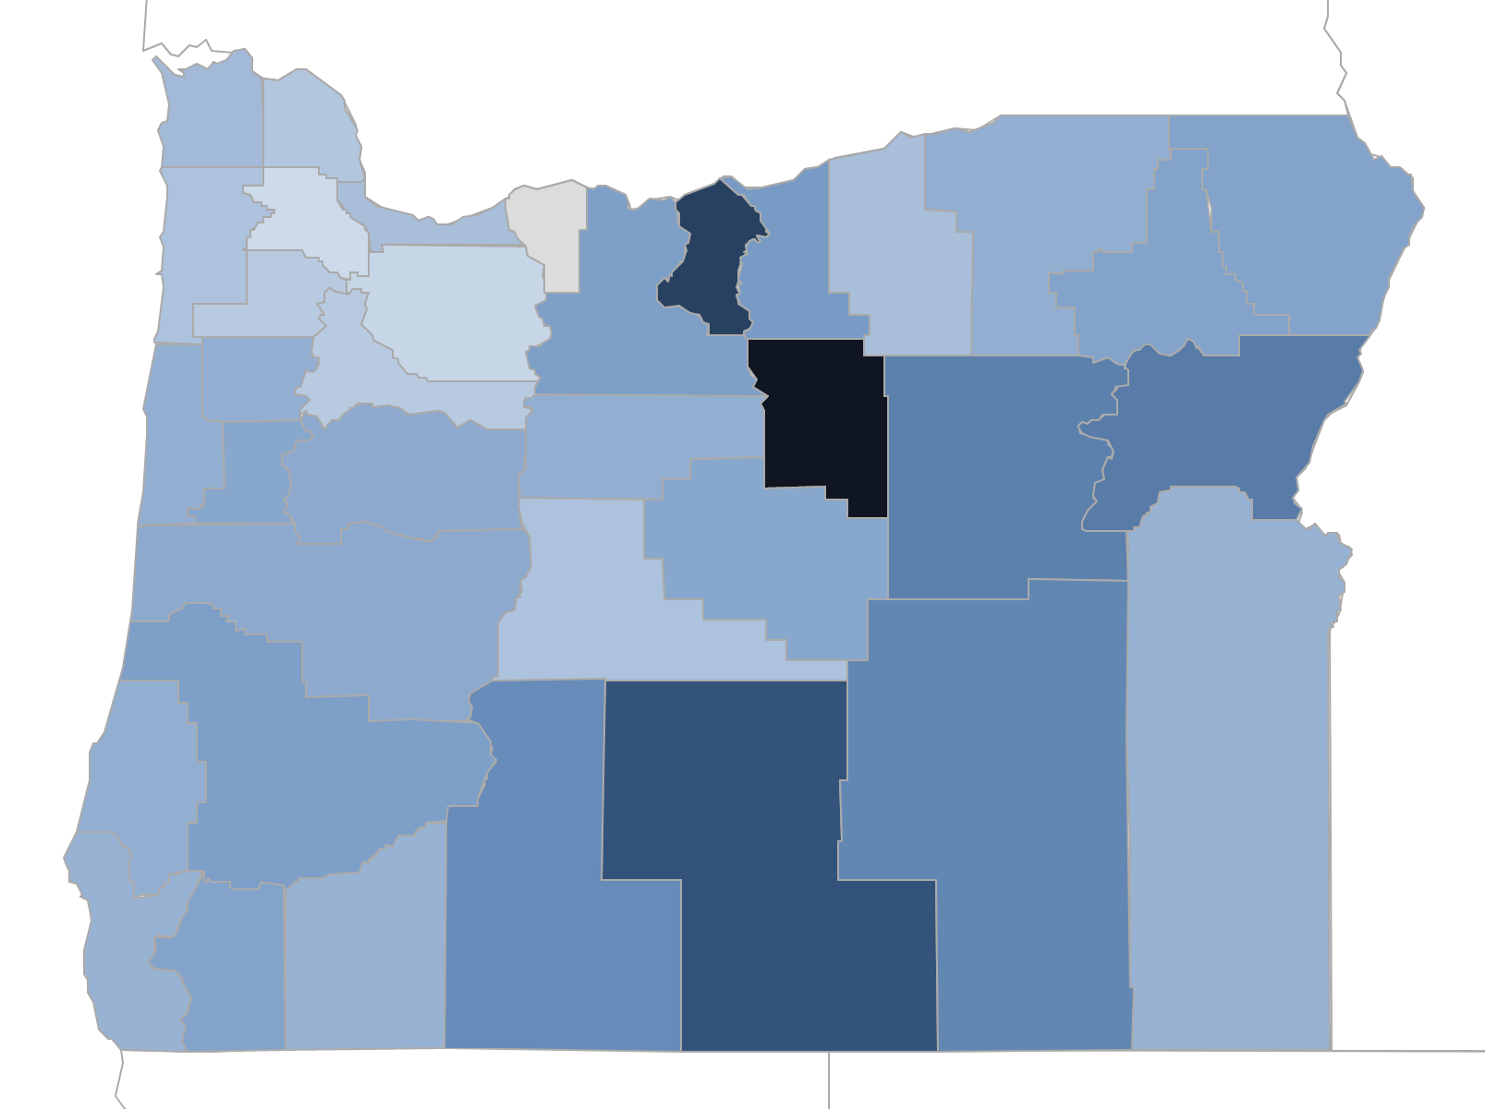
Portland: Selected variables
Originally planned to look at how environmental factors and access affect diabetes rates in counties (grocery stores, food services, hospitals)
Expanded data collection to other factors:
HS graduation rate, poverty, percent obesity, unemployment, physical activity, income, food insecurity
Food environment index: measures limited access to healthy foods and food insecurity

Slide 15
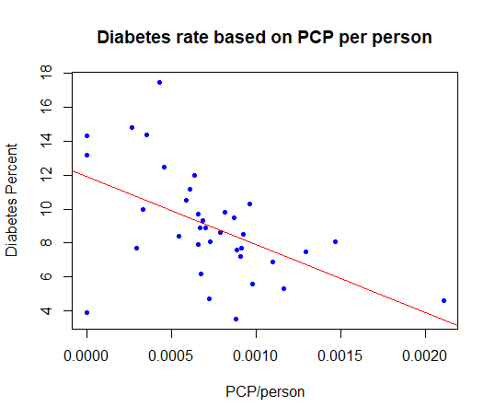
Portland: Findings
Original variables:
Percent with limited access to healthy foods (R = 0.20) and grocery stores per person (R = -0.16) not statistically significant (p>>0.05)
Food services per person (R = -0.45) and primary care providers (PCP) per person (R = -0.51) were more significant relationships

Slide 16
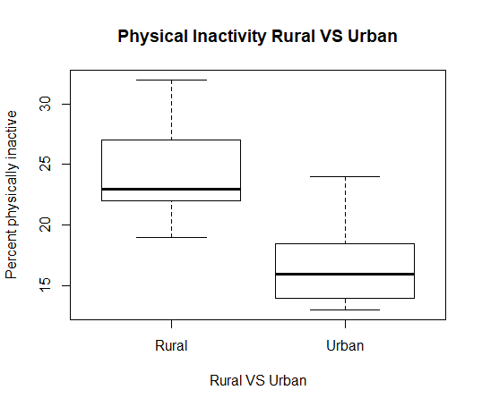
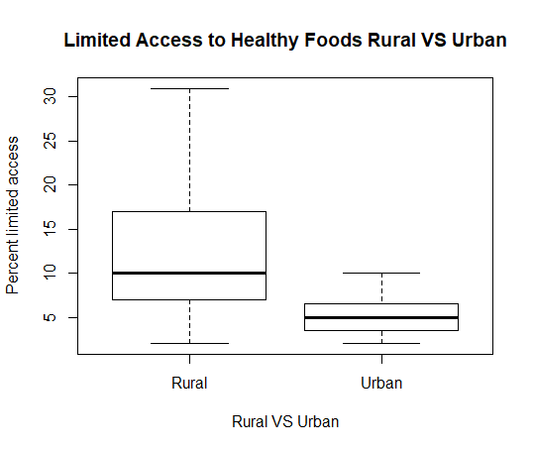
Portland: Findings
Differences between rural and urban counties
p = 3.483e-05 (Welch 2-sample t-test)
p = 0.000163 (Welch 2-sample t-test)

Slide 17
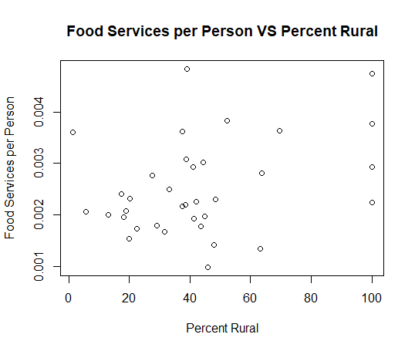
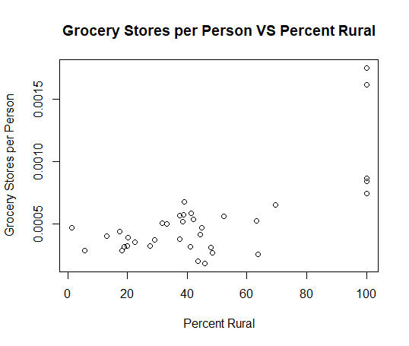
Portland: Interesting Findings
Lack of relationship between food insecurity and diabetes prevalence
Positive relationship between number of grocery stores and food services and percent rurality of a county

Slide 18
Portland: Mediation
Physical Inactivity (X) → Percent Obesity (M) → Diabetes Rate (Y)
X on Y: Physically inactive percent + Diabetes rate (p=0.0465)
X on M: Physically inactive percent + Percent obesity (p=0.00455)
ACME (Average Causal Mediation Effect): 0.1525 with p = 0.004 found to be significant
Proportion mediated: 0.652
Causal Mediation Analysis:
Estimate 95% CI Lower 95% CI Upper p-value
ACME 0.1525 0.0303 0.32 0.004 **
ADE 0.0778 -0.1378 0.29 0.460
Total Effect 0.2303 0.0360 0.45 0.028 *
Prop. Mediated 0.6519 0.0876 2.62 0.032 *

Slide 19
Portland: Notes
Due to small sample size (n=36), lack of relationships between certain variables could be due to low power of statistical tests
Some counties have very low populations (ex: Wheeler with 1344 people), and so their data might not be very accurate and/or could be skewed easily when using percents
When using ML models, because of small sample size, data is prone to overfitting and not making accurate predictions for test sets versus training sets

Slide 20
Moving Forward
Sundari
Looking at different ML models and comparing accuracy between them
Using the most important/significant variables VS all collected variables
Attempting to make final conclusions about diabetes prevalence in Oregon counties from data analysis and ML models
Paulina
Trends/Results from Mediation Analysis to guide ML model
Which variables to use
Exploring several different regression techniques within ML to create a model that accurately predicts a community area’s diabetes rate
Make some conclusions about potential solutions based upon these results

